Slide 1
AUTOMATED ONE AXIS DRILL
GROUP MEMBERS
1. Mary Mbaire -Programming
2. Renox Kipkoech- Computational Analysis
3. Morris Lesinko- MATLAB
4. Philip Katiechi- Circuitry
5. Allan Kyalo- FEA
6. Stephen Gitau- Circuitry
Supervisor: Dr. Titus Mulembo

Slide 2
TABLE OF CONTENTS
Abstract..………………………………………………………………..4
Introduction..………………………………………………………….5
Background………………………………………………………..5
Problem Statement…………………………………………...6
Objectives………………………………………………………….8
Existing Physical Model…………………………………………..9
Methodology…………………………………………………………10
Physical Model Design……………………………………...12
Physical MATLAB Simscape Model…………………….13

Slide 3
Physical MATLAB Simscape Model…………………….12
Firmware Code…………..……………………………………..13
Project Circuit……………………………………………………17
Circuit Simulation………………………………….............18
PID Tuning of DC Motor Speed………………………….19
Mathematical Analysis…...…………………………………22
Stress Distribution Analysis in ANSYS…………………24
Temperature Analysis in ANSYS………………………….25
Next Semester Objectives……………………………………….26
Next Semester Time Plan…………………………….............27

Slide 4
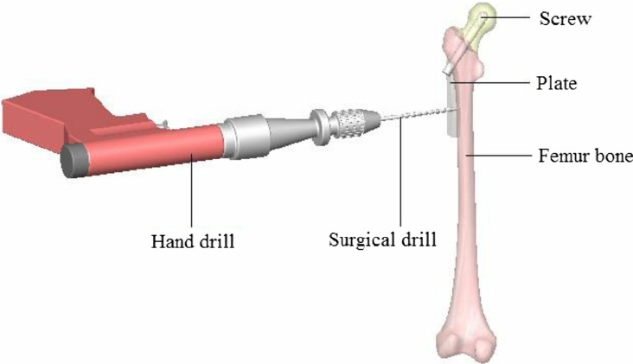
Abstract
High quality drilled holes are required in a lot of industrial and medical applications. This project focuses on the development of a one-axis drill system utilizing a polymer workpiece for improving bone drilling operations in medical applications.
Source:
https://shorturl.at/dBOW6
By Arif Gok

Slide 5
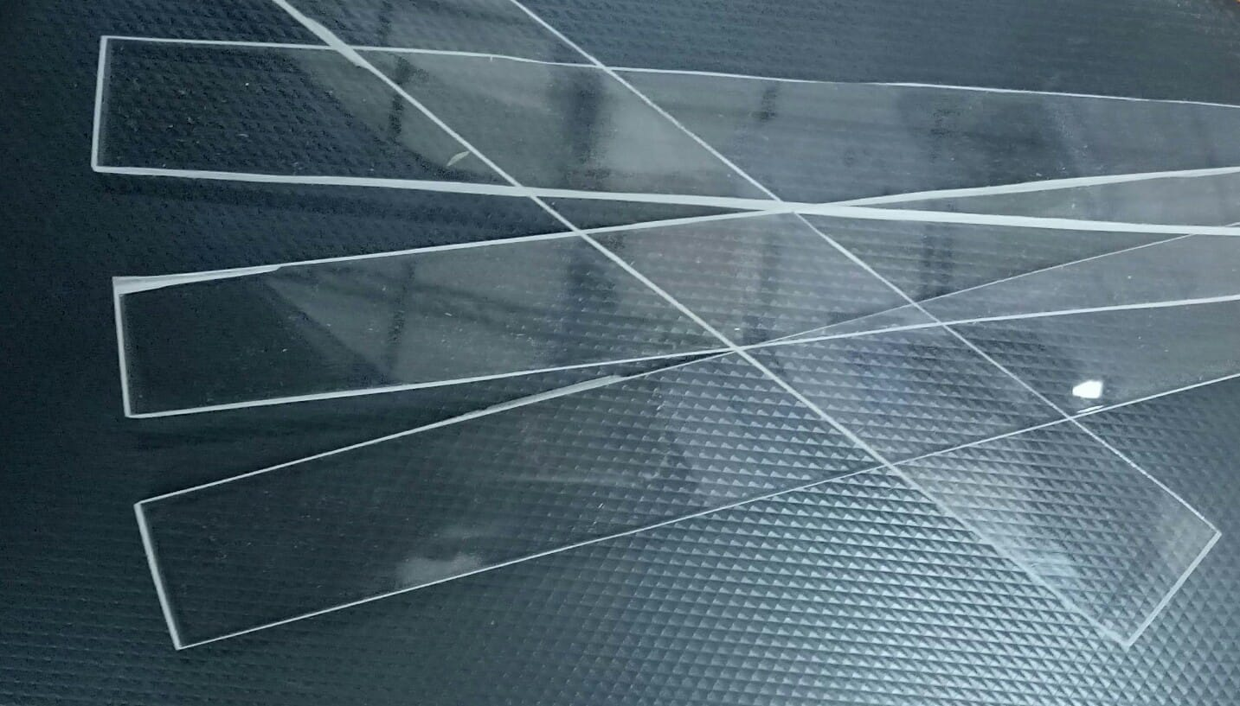
Introduction
1.Background
Polymethylmethacrylate (PMMA) is a versatile material known for its properties that make it similar to human bone. Its nature enables clear visibility in medical imaging, making it suitable for orthopedic surgeries.

Slide 6
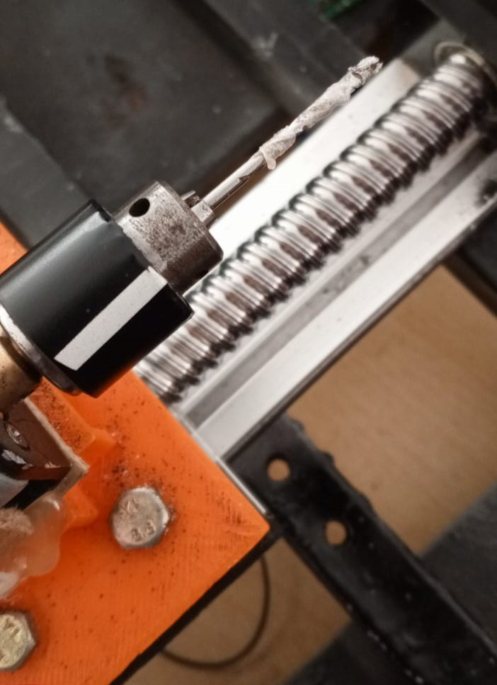
2.Problem statement
Challenges in the drilling process include unmonitored and unregulated vibrations, chatter, work piece damage, melting of workpiece, drill bit breakage and misaligned or poor quality holes.

Slide 7
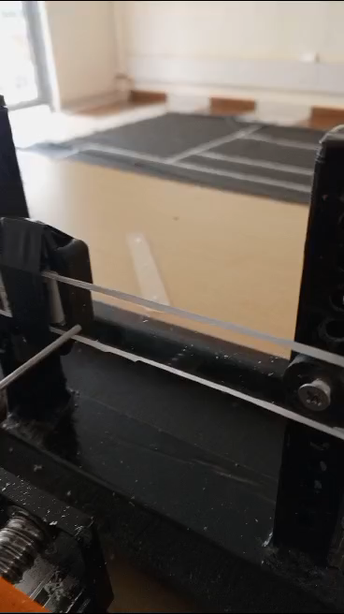
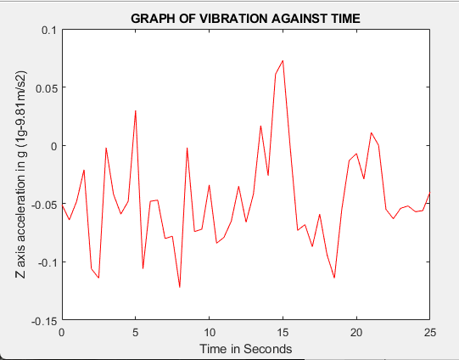
Drilling Operation Experiment
Observed Vibrations

Slide 8
3.Objectives
Main Objective
Development of a precise automated one axis drill.
Specific Objectives
To design & simulate 3D model of physical system
To develop efficient circuitry and firmware
To do analysis and determine parameters for
vibration mitigation and efficient drilling

Slide 9
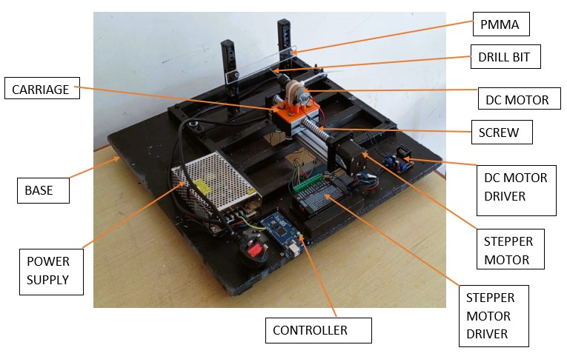
Existing Physical Rig

Slide 10
Methodology
Physical Model Design in SolidWorks
MATLAB Motion Simulation
MATLAB Simscape Model
Simulation in Simscape
3. Firmware Code
DC and Stepper Motor Code
Load Cell Code
Temperature Code

Slide 11
4. Project Circuitry
Fritzing Circuitry
Circuit Simulation
5. Mathematical Analysis
Force and deflection analysis
Temperature Analysis
6. Stress Distribution Analysis in Ansys
7. Temperature Analysis in Ansys

Slide 12
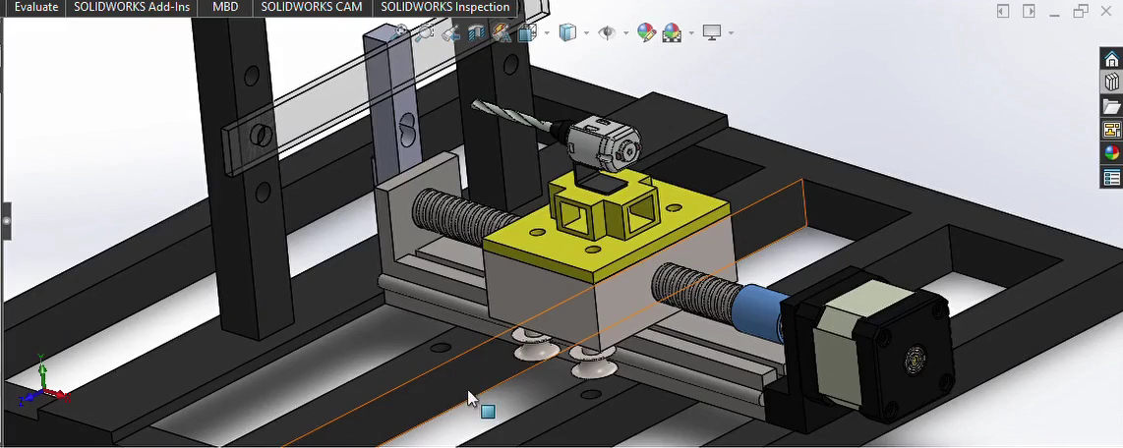
Physical Model Design in SolidWorks

Slide 13
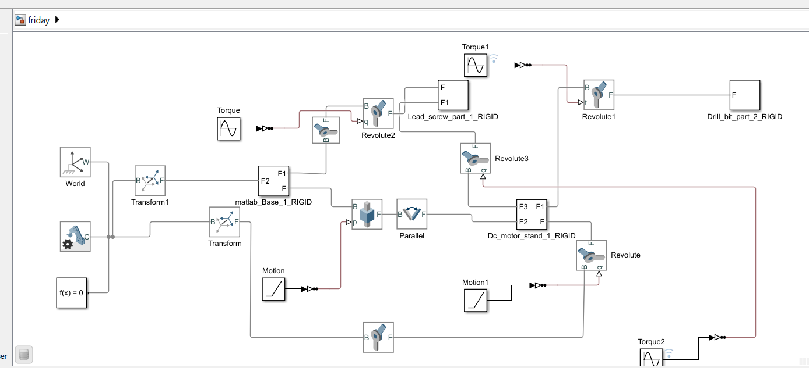
MATLAB Simscape Model
The assembly multibody contains both revolute and prismatic joints which work together to output the desired motion of the model.

Slide 14
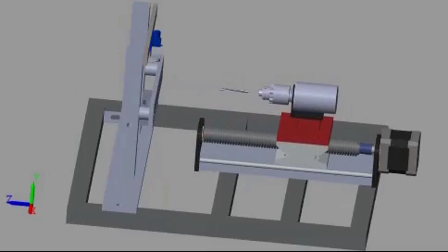
Motion Simulation in MATLAB
An input torque or motion is provided to the joints the position is automatically computed.

Slide 15
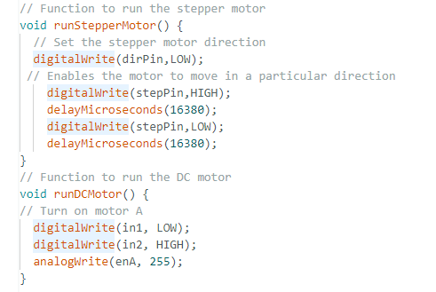
Firmware code
1. DC and Stepper Motor Code

Slide 16
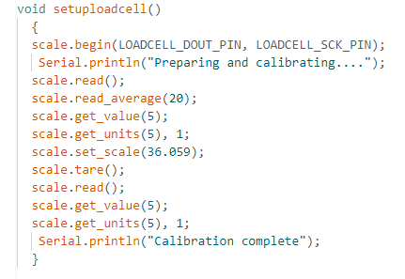
2.Load Cell Code

Slide 17
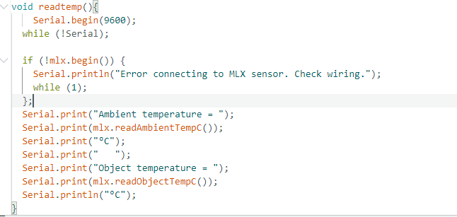
3. Temperature Sensor Code

Slide 18
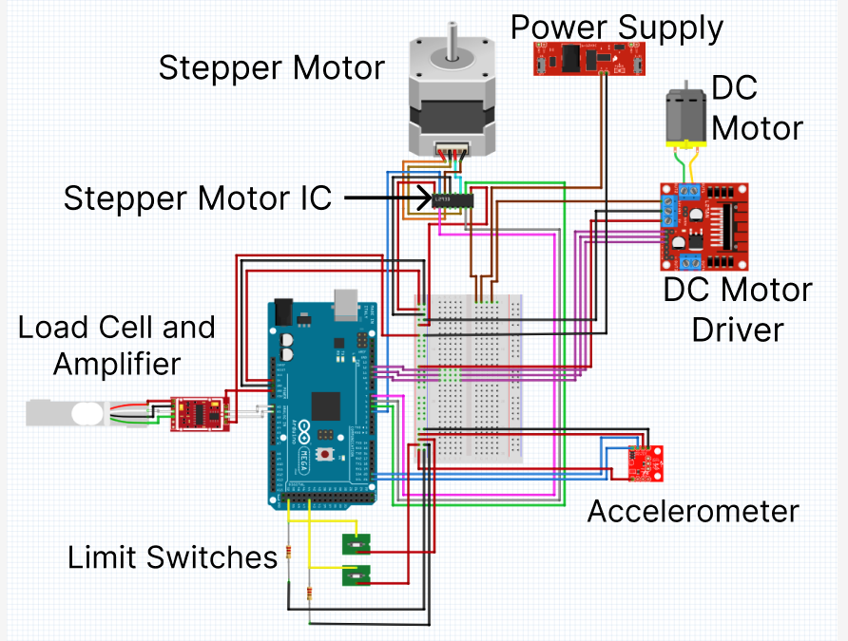
Project Circuit

Slide 19
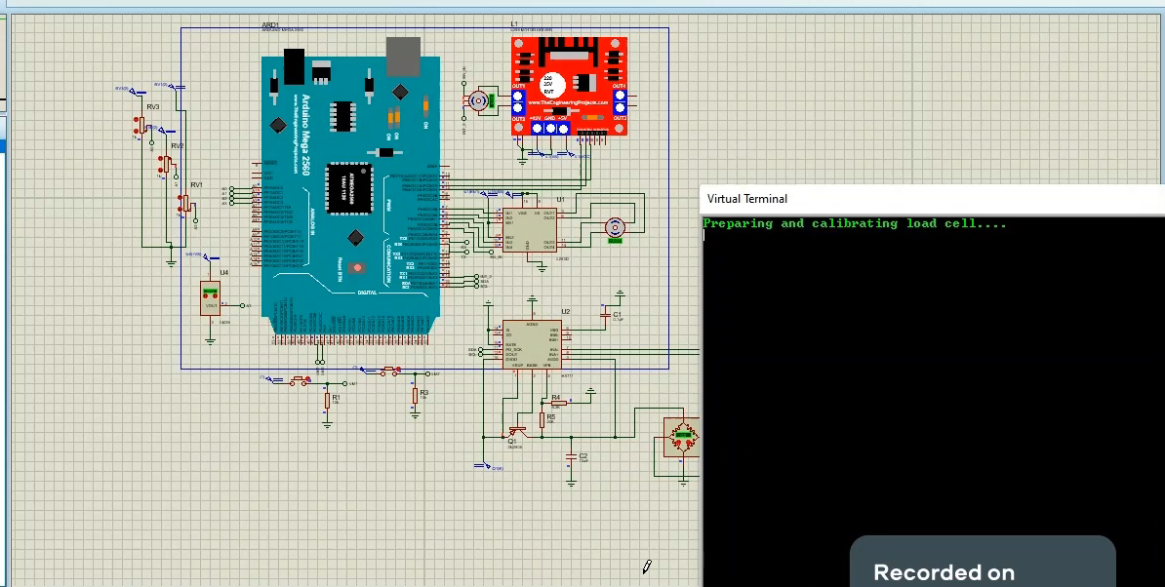
Full Circuit Simulation

Slide 20
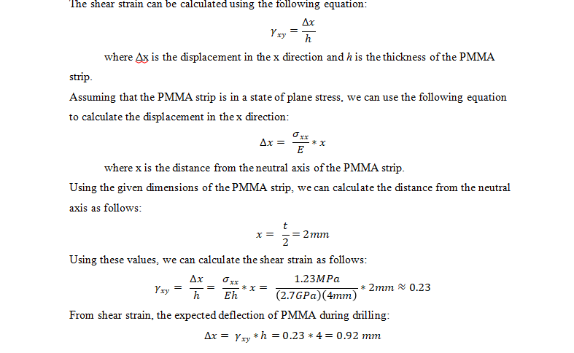
Mathematical Analysis
1. Force and deflection analysis

Slide 21
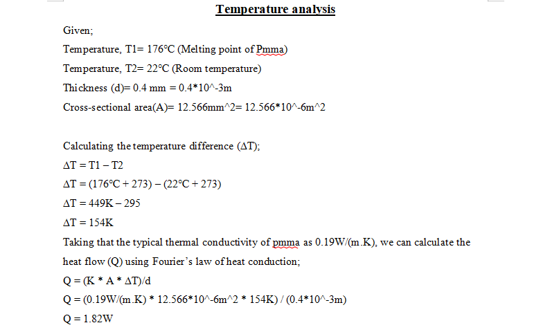
2. Temperature Analysis

Slide 22
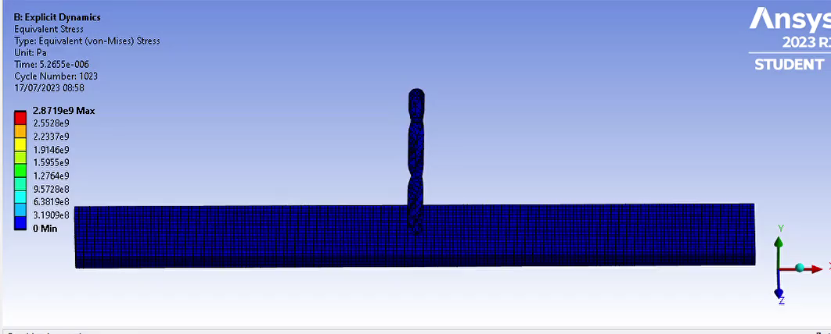
Stress Distribution Analysis in ANSYS
Drill speed at 9600 RPM
PMMA Mesh Size: 0.001m
Drill bit Mesh Size: 0.004m

Slide 23
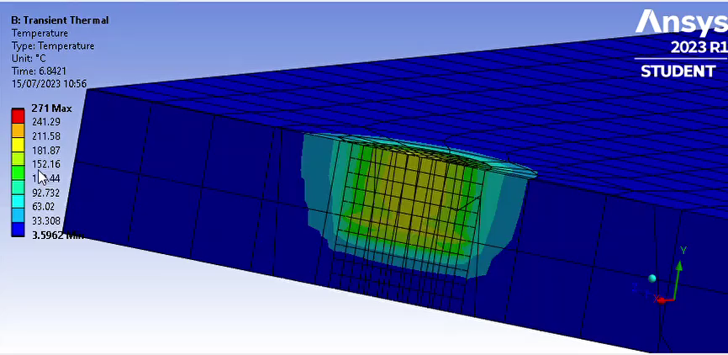
Temperature Analysis in ANSYS
PMMA Mesh Size:0.004m

Slide 24
Next semester objectives
1. Carry out experiments to determine best drilling
parameters.
2. Carry out statistical analysis of actual drill
parameters.
3. Vibration mitigation for high quality drilled holes.
4. Run physical model of automated drill.
5. Monitor drilling parameters in real time.

Slide 25
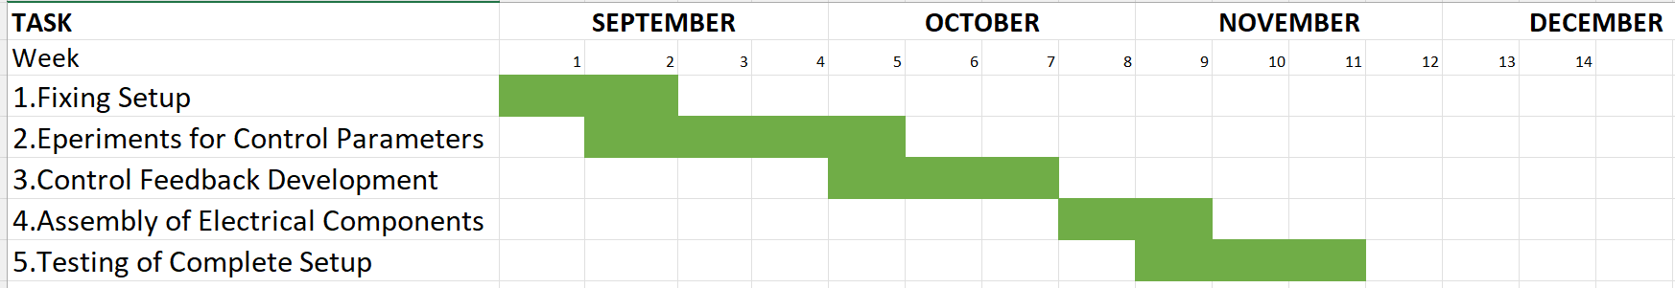
Next Semester Time Plan

